Slide 1
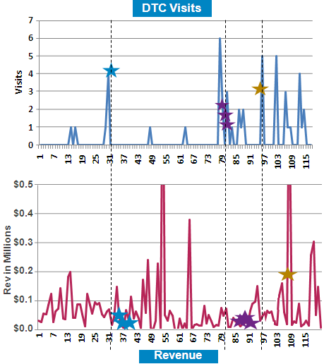
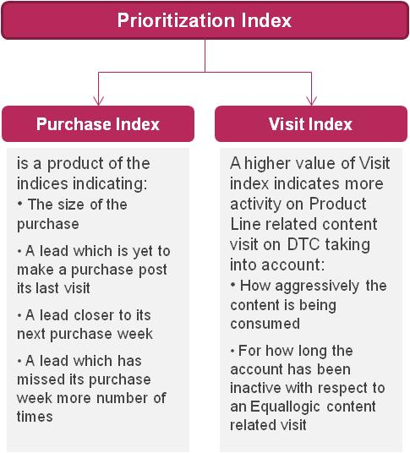
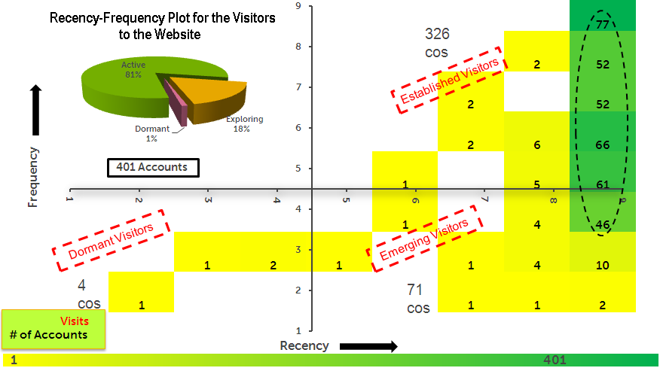
Mu Sigma estimated the impact of social media activity on sales and improved customer engagement through customized content
Background
Insights & Recommendations
The Client is a Fortune 500 IT solutions company
The Client has a collaborative online community where visitors can get in-depth technical information about the products, participate in discussions, download content, post queries, etc.
The Client wants Mu Sigma to:
Determine the impact of the website on the business
Use Social Media for targeting its business customers better
Strong correlation was observed between visits and revenue generated
Visitors to the site showed a higher product penetration and incremental revenues
Leads generated from the website were prioritized for targeting
Analytical Approach
Business Impact
Improved engagement on the website by improving content
Identified potential customers
Results indicated that significant sales opportunity was generated
Integrate the community websites into their customer acquisition and retention strategies
Sales leads
funnel
220
39
10

